Slide 1


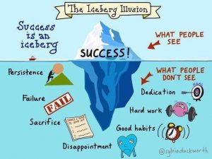
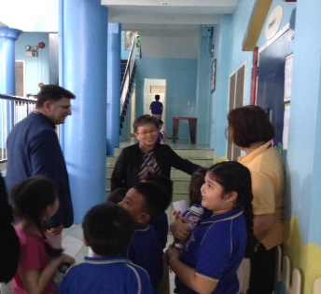
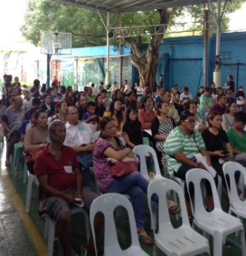
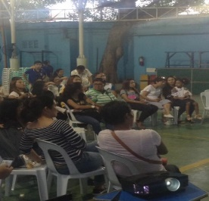
Paulinian Newsletter
Beaconhouse St. Paul’s Official School Publication
Vol. 1 Issue 1
JULY 2018
WELCOME TO SUCCESS!
July 2, 2018– Wake up! Summer has just ended and now it’s time for us to begin another remarkable school year in Beaconhouse St. Paul. It is so refreshing to be back in school and start with a bang.
The day started with a morning prayer followed by the singing of the Philippine National Anthem and St. Paul’s Hymn which was led respectively by our dear Paulinians.
New school year also means fresh new faces who will make this year even more memorable.
With students coming from different schools with different nationalities, this year will surely bring a lot of excitement and fun memories.
Let us fill our minds and hearts with positive expectations coupled with continuous hardwork and perseverance as we embrace success.
-Achille Enzo Lanutan, Grade 9 Student
Welcome to St. Paul Learning Center, Inc., a Beaconhouse School, for school year 2017-2018. We are glad to have you as part of our growing family. Thank you for choosing our school to be your child’s partner in growth, development and success. We take this trust wholeheartedly and we commit to give quality education, embodying Filipino values in an international environment.
We look forward to our collaborative partnership. Home and school must work together in order to ignite your child’s success.
SHORT NEWS
Photo by: Adam Khoo (google)
Beaconhouse Officials Visited SPLC For School Evaluation
July 4, 2018, Miss Sumitra Krishnan, Regional Finance Officer of Beaconhouse School System visited SPLC together with Ms. Riffat Zareen, Country Head and Mr. Randolf Deguzman, Finance Country Manager. On July 13, 2018, Mr. Ali Raza, Regional Director of Southeast Asia, Beaconhouse School System also paid us a quick visit for a short meeting with the school’s administrator and met with the faculty and staff.
WEEKLY ACTIVITIES
CATEGORY A
1st Week -Coloring Activity
2nd Week - Poem Making & Poem Recitation
CATEGORY B
1st Week –Poster Slogan Making
2nd Week - Collage Making
3rd Week– Interpretative Dance
CATEGORY C
1st Week –Poster Making
2nd Week - Song Composition
3rd Week– Advertisements
Photo by: Beaconhouse St. Paul
SPLC Welcomes Parents For S.Y. 2018-2019
July 11 & 12, 2018— The Preschool Department had their Parents’ Orientation. It was led by Teacher Froilyn Montecillo. Dr. Sandra Genova headed the Grade School, Junior High School and Senior High School Departments. Discussion through powerpoint presentations were done by some faculty members. They were focused on the following; Vision-Mission, Grading System, Academic Policies and School Rules and Regulations. The parents were fully informed as there were numerous changes in some school policies.
Photo by: Beaconhouse St. Paul
SPLC Elects Parents’ Council For S.Y. 2018-2019
July 12, 2018— For a prosperous year, the former Parents’ Council Officers initiated the election of this school year’s parent leaders. They voted for the most effective and efficient parents who could lead them to profitable projects and aim for the betterment of the school. The elected officers then compromised on their busy schedules to be able to meet and plan for this year’s projects.
Photo by: Beaconhouse St. Paul
Continue to page 2

Slide 2

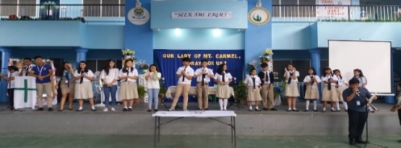
2
BE SMART. EAT SMART.
July 2018– SPLC celebrated Nutrition Month. According to the National Nutrition Council, nationwide celebration of Nutrition Month increases awareness of pressing Nutrition concerns. It also aims to contribute to improved food and nutrition security by increasing access to a diversified source of food for families and communities alike . SPLC, in line with NNC celebrates this year’s theme, “Ugaliing Magtanim, Sapat na Nutrisyon Aanihin!”
The Preschool students had a lot of activities to fully realize these goals. They started the month with Cooking and Food Tasting of Go, Grow, and Glow Foods. Students brought nutritious ingredients for their various healthy snacks and lunch preparations. This activity emphasized the importance of making right food choices smartly. They also had “Trip to a Grocery Store in One Pavilion” where they got to buy nutritious products that they love. Along with them were their teachers and guardians. They had so much fun walking around the store and looking for their favorite food and drinks.
This month is truly worth remembering not only for the fun activities but also the goal of keeping one’s body healthy by choosing right and eating right .
- Sofia Lauren Jayme, Grade 9 Student
Photo by: Nutrition Education Store (google)
STUDENTS’ CORNER
STUDENTS ENGAGING IN WRITTEN EXPRESSIONS
“Be True, Express Yourself” is a famous tagline from a branded line of clothing. It became famous for it encouraged people of all ages to express themselves.
Young adolescents especially students, love to convey their messages through chit chat and online messaging. Through these ways, students are able to share their ideas and thoughts to their friends, siblings, classmates and even elders. Some feelings buried deep within, may not be seen but at least they can be expressed in other ways.
In school, students are given freedom to pour out their emotions through written activities such as poetry writing, song composition, slogan/poster making, essays, story writing and narratives. Using these literary activities, they are able to put their ideas, beliefs and hidden opinions in written outputs.
These kind of tasks will surely boost their confidence and enhance their creativity. It will also widen their imagination and open their minds to a new perspective.
- Bianca Pauleena Bolongan, Grade 10 Student
Important Dates to Remember
August
21 | Eid’ul Adha
24 | Preschool Dress Up like Mom and Dad
27 | National Heroes Day
31 | Buwan ng Wika Culmina-ting Activity
NEWLY ELECTED SSG OFFICERS
ELEMENTARY:
PRESIDENT : Nina Borja
VICE PRESIDENT : Jorel Ocaba
SECRETARY : Kaisha Montinola
ASSISTANT SECRETARY : Alexa Miles Tan
TREASURER : Caroline Camu
AUDITOR: Eliana Jumonong
P.I.O : Princess Aniñon
HIGH SCHOOL:
PRESIDENT : Chenne Yvette Torbeles
VICE PRESIDENT : Sofia Lauren Jayme
SECRETARY : Achille Lorenzo Lanutan
ASSISTANT SECRETARY : Sebastian Tabares
TREASURER : Holiver Bustillo
AUDITOR : Alfred Theress Labra
P.I.O : Christine Eunice Dalagan
GRADE LEVEL REPRESENTATIVES
GRADE 7: Mary Claire Limson
GRADE 8: Rafael Christian Ronccesvalles
GRADE 9: Jeg Baltazar
GRADE 10: Jimin (Amy) Hwang
GRADE 11: Maevan Rose Durterte
GRADE 12: Charin Onyou Chae
Photo by: T. Edz Moscoso

